Slide 1

Week 4: Data Exploration and visualization
DR. Bisan A N Alsalibi
SCHOOL OF COMPUTER SCIENCE
Taylor’s University

Slide 2
Outline
Data exploration step
Exploratory Data Analysis in Pandas
Data Visualization in Python
Matplotlib
Seaborn

Slide 3
Data Exploration
During exploratory data analysis you take a deep dive into the data.
Information becomes much easier to grasp when shown in a picture, therefore you mainly use graphical techniques to gain an understanding of your data and the interactions between variables.
The goal isn’t to cleanse the data, but it’s common that you’ll still discover anomalies you missed before, forcing you to take a step back and fix them.

Slide 4
Data Visualization Objectives
Record information
Analyze data to support reasoning
Confirm hypotheses
Communicate ideas to others
Answer questions (or discover them)
Make decisions

Slide 5

Why Visualize
To record information

Slide 6
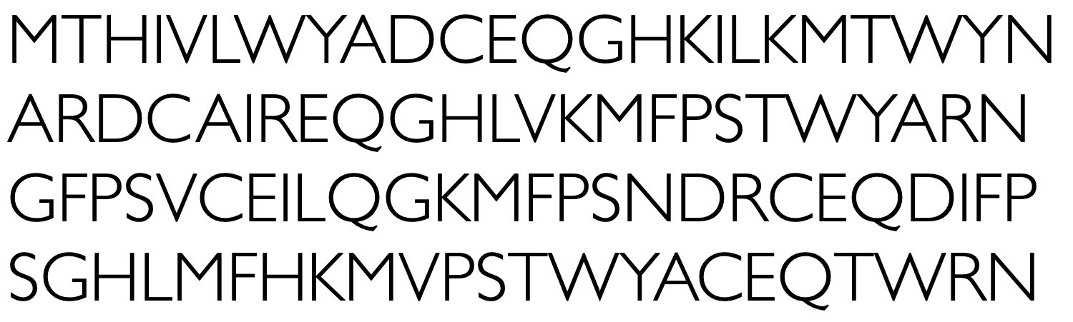
Why Visualize
To point out interesting things

Slide 7
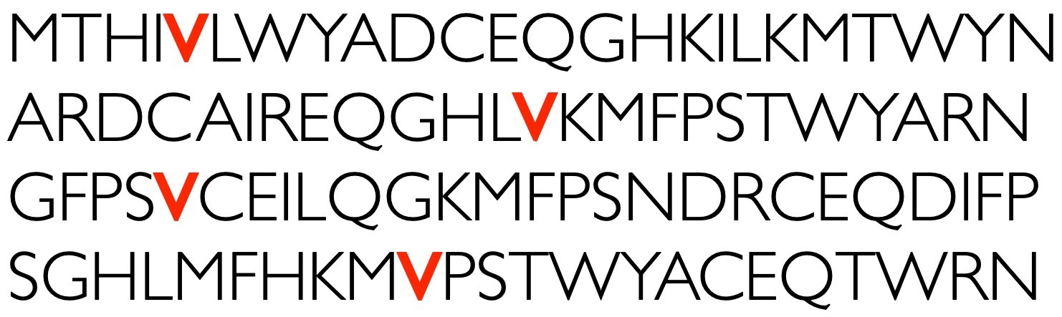
Why Visualize
To point out interesting things

Slide 8
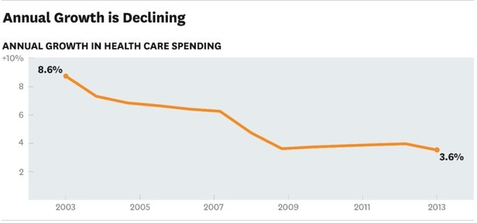
Why Visualize
To communicate information

Slide 9
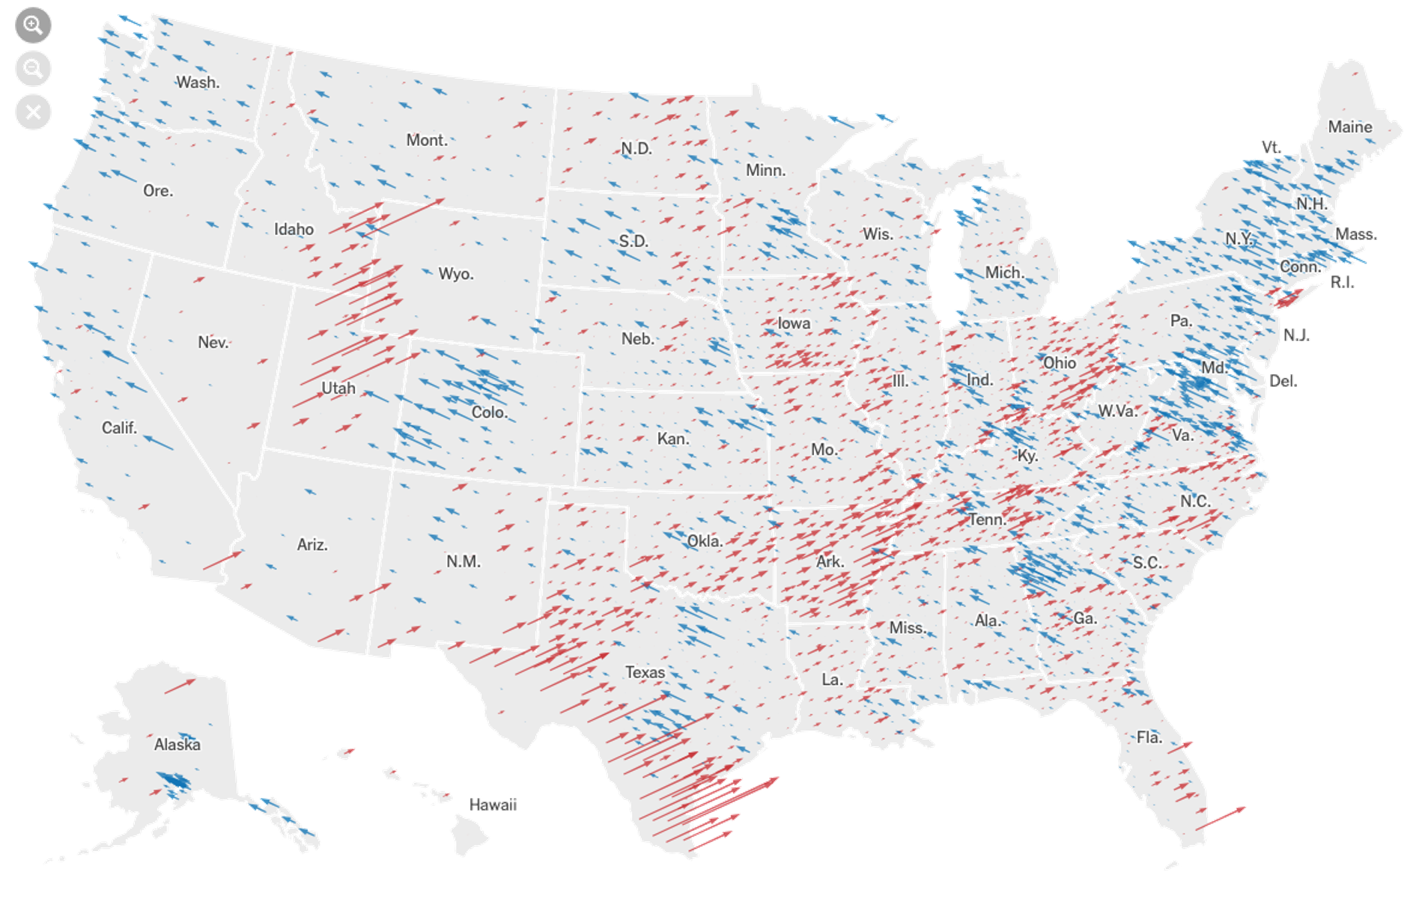
Why Visualize
To analyze data
2020 US Elections (NYTimes)

Slide 10


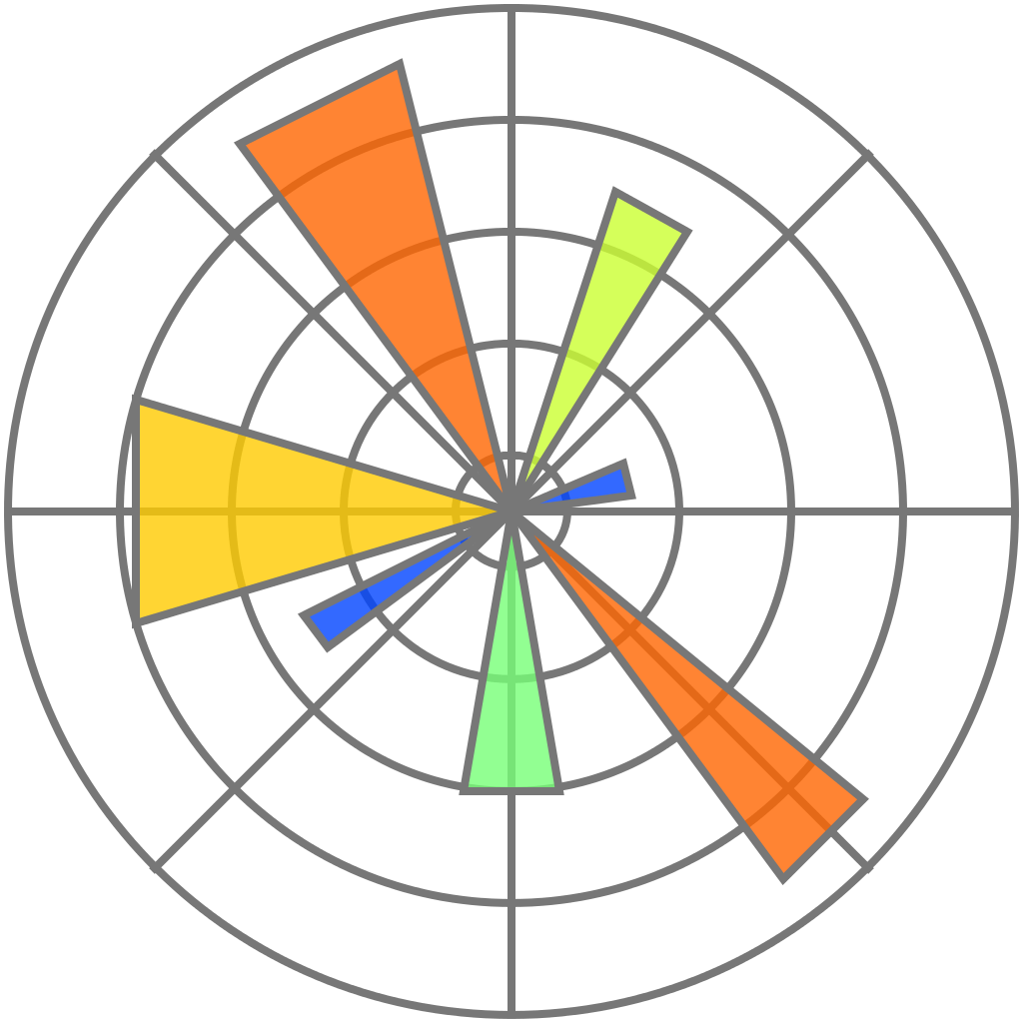

Useful Python Libraries
NumPy
pandas
matplotlib
seaborn

Slide 11
NumPy
Fundamental package for scientific computing
Exceptionally fast – written in C
Main data structure:
ndarray : n-dimensional arrays of homogeneous data types
Data manipulation ≈ NumPy array manipulation
Used in other libraries - Matplotlib, pandas, scikit- learn

Slide 12
Pandas
Fundamental tool for handling and analyzing input data
Particularly suited for tabular data
Implements powerful data operations
Main data structures:
DataFrame: A table with rows and columns
Series: A single column

Slide 13
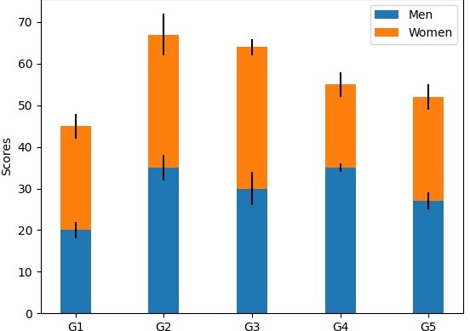
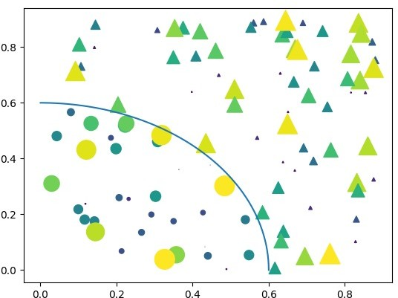
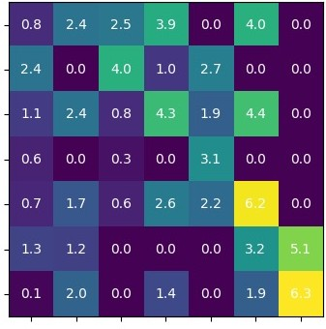
Matplotlib
Used for basic plotting
Highly customizable
Works with NumPy and pandas

Slide 14
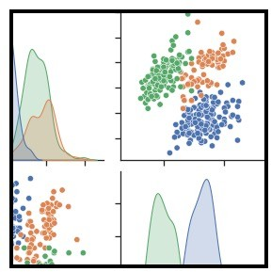
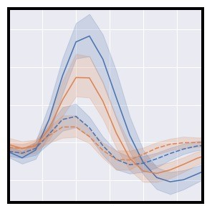
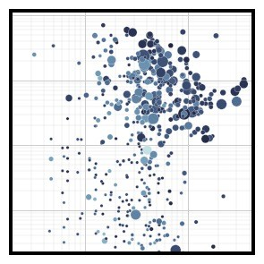
Seaborn
Used for statistical data visualization
Uses fewer syntax with good default themes
Integrated to work great with pandas data-frame
Uses Matplotlib under the hood

Slide 15
Benefits of Seaborn
Seaborn offers:
- Using default themes that are aesthetically pleasing.
- Setting custom colour palettes.
- Making attractive statistical plots.
- Easily and flexibly displaying distributions.
- Visualising information from matrices and DataFrames.
The last three points have led to Seaborn becoming the exploratory data analysis tool of choice for many Python users.

Slide 16
Types of Plots
Line plots
Bar plots
Scatter plots
Box plots
Histograms
Notes:
The basic plotting that Matplotlib offers are

Slide 17
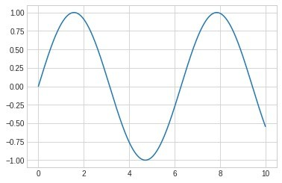
Line plots
Used for numeric data
Used to show trends
Compare two or more different variables over time
Could be used to make predictions

Slide 18
Visualization using Matplotlib
import matplotlib.pyplot as plt
%matplotlib inline
import numpy as np
Create a dataset
x = np.linspace(0, 20, 10)
y = x ** 2
print((x,y))

Slide 19
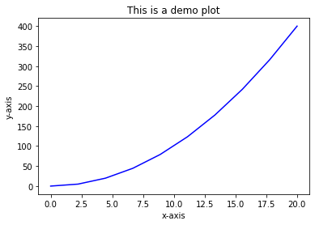
1 plt.figure()
plt.figure()
plt.plot(x, y, ‘b')
plt.xlabel('x-axis')
plt.ylabel('y-axis')
plt.title('This is a demo plot')
plt.show()
Notes:
The figure() function in pyplot module of matplotlib library is used to create a new figure.

Slide 20
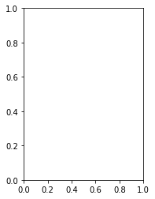
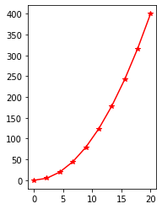
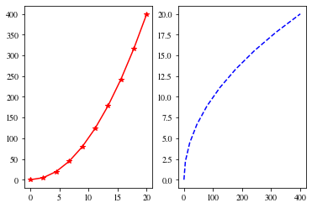
2. plt.subplot(nrows=1,ncols=2,1)
plt.subplot(1,2,1)
plt.subplot(1,2,1)
plt.plot(x, y, 'r*-')
plt.subplot(1,2,2)
plt.plot(y, x, 'b--');
plt.subplot(1,2,1)
plt.plot(x, y, 'r*-')

Slide 21
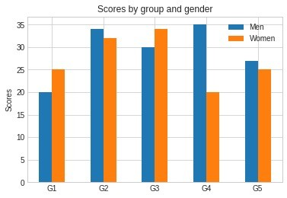
Bar plots
Used for nominal or ordinal categories
Compare data amongst different categories
Ideal for more than 3 categories
Can show large data changes over time

Slide 22
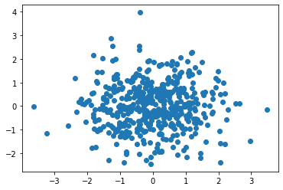
Scatter plots
Used to visualize relation between two numeric variables
Used to visualize correlation in a large data set
Predict behavior of dependent variable based on the measure of the independent variable.

Slide 23
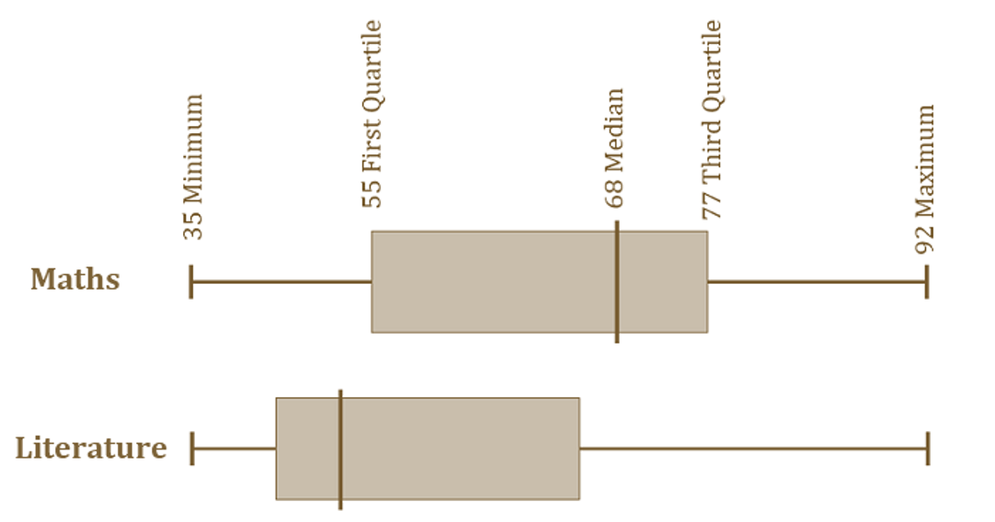
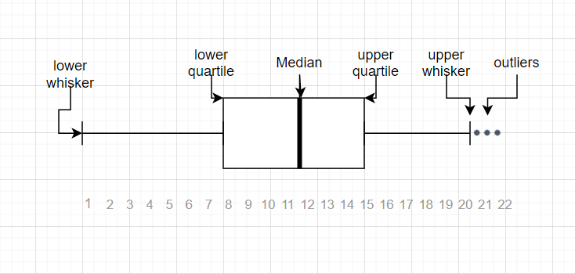
Box plots
aka whisker plot
Statistical graph used on sets of numerical data
Shows the range, spread and center
Used to compare data from different categories

Slide 24
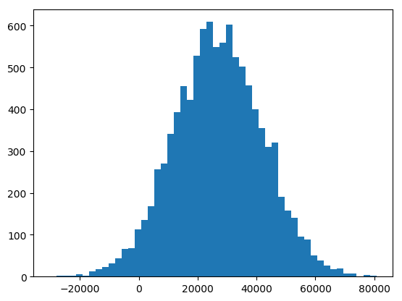
Histograms
Used for continuous data
Displays the frequency distribution (shape)
Summarize large data sets graphically
Compare multiple distributions

Slide 25
Plotting with Seaborn
One of Seaborn's greatest strengths is its diversity of plotting functions.
Most plots can be created with one line of code.
For example….
Notes:
Seaborn is a Python data visualization library based on matplotlib. It provides a high-level interface for drawing attractive and informative plots

Slide 26
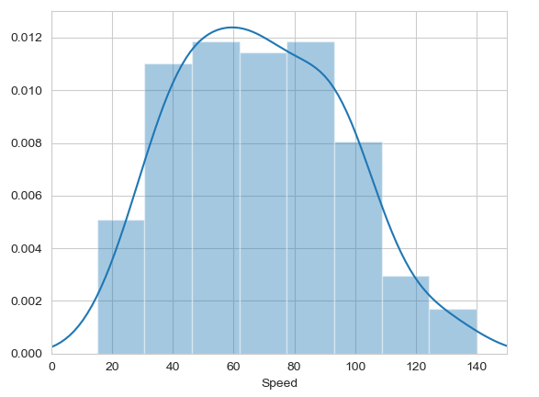

Histograms
Allow you to plot the distributions of numeric variables.

Slide 27
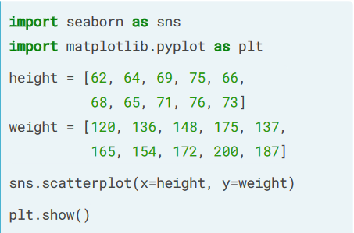
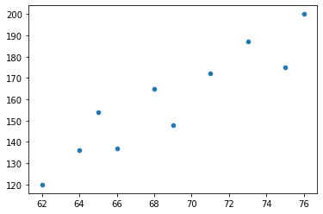
Scatter plot

Slide 28
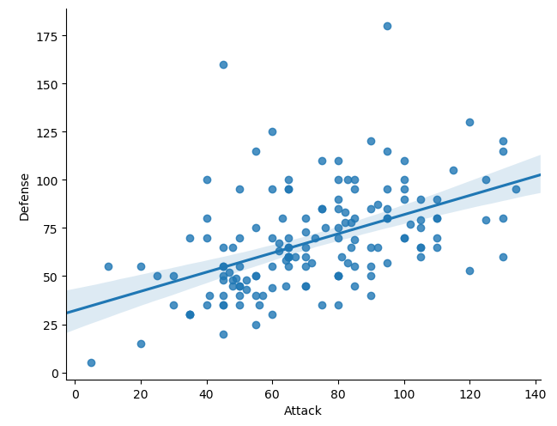
Other types of graphs: Creating a scatter plot with regression line
Name of our dataframe fed to the “data=“ command
Name of variable we want on the x-axis
Seaborn “linear model plot” function for creating a scatter graph
Name of variable we want on the y-axis

Slide 29
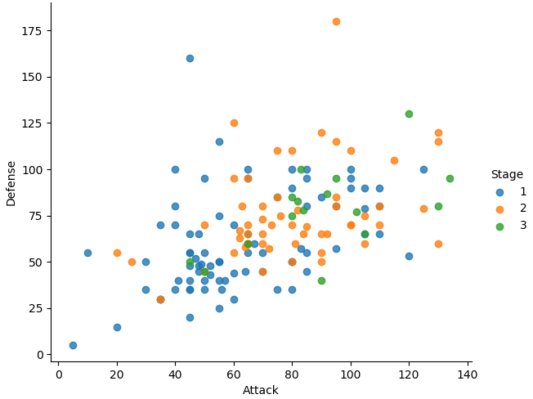

The hue function
Another useful function in Seaborn is the hue function, which enables us to use a variable to colour code our data points.
Notes:
Hue is another column in the dataframe and here it is the stage column

Slide 30
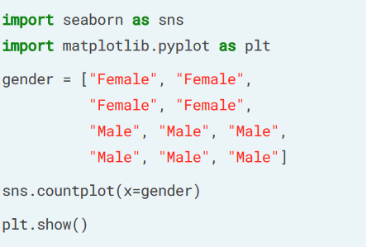
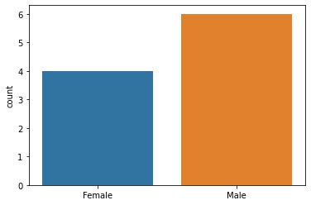
Count plot

Slide 31
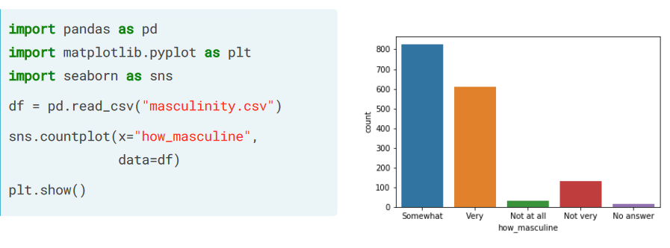
Using DataFrames with countplot()

Slide 32
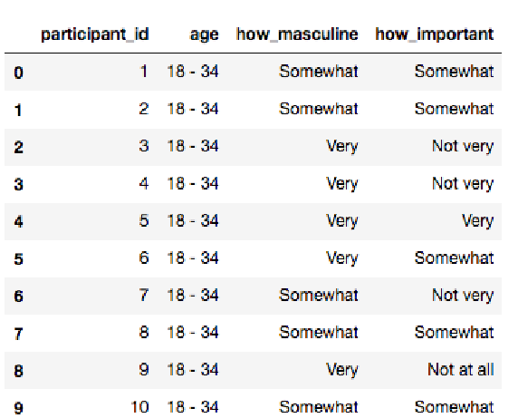
Using DataFrames with countplot()

Slide 33
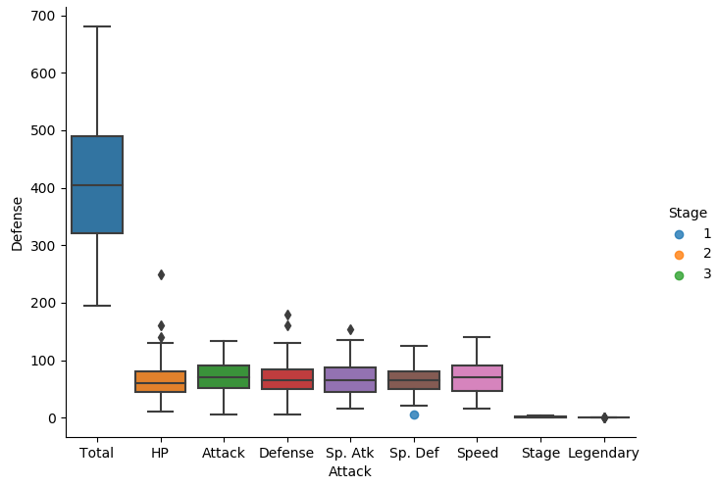

A box plot

Slide 34
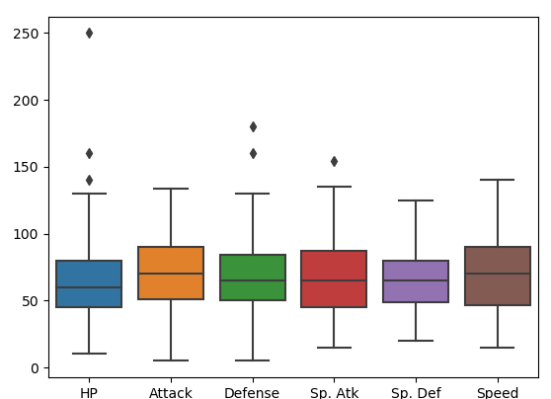
A box plot
The total, stage, and legendary entries are not combat stats so we should remove them.
Pandas makes this easy to do, we just create a new dataframe
We just use Pandas’ .drop() function to create a dataframe that doesn’t include the variables we don’t want.

Slide 35

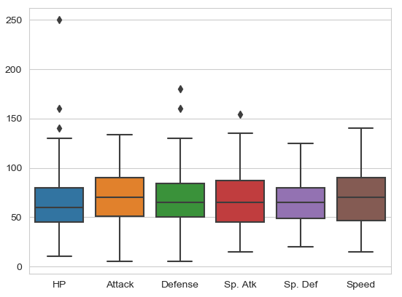
Seaborn’s theme
Seaborn has a number of themes you can use to alter the appearance of plots.
For example, we can use “whitegrid” to add grid lines to our boxplot.

Slide 36
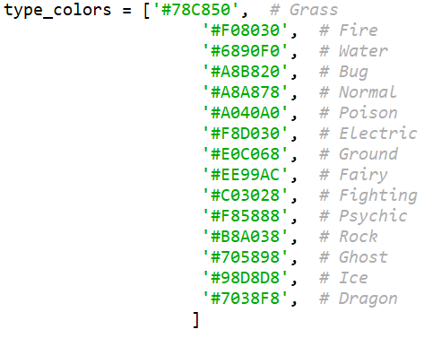
Seaborn’s colour palettes
Seaborn allows us to easily set custom colour palettes by providing it with an ordered list of colour hex values.
We first create our colours list.

Slide 37

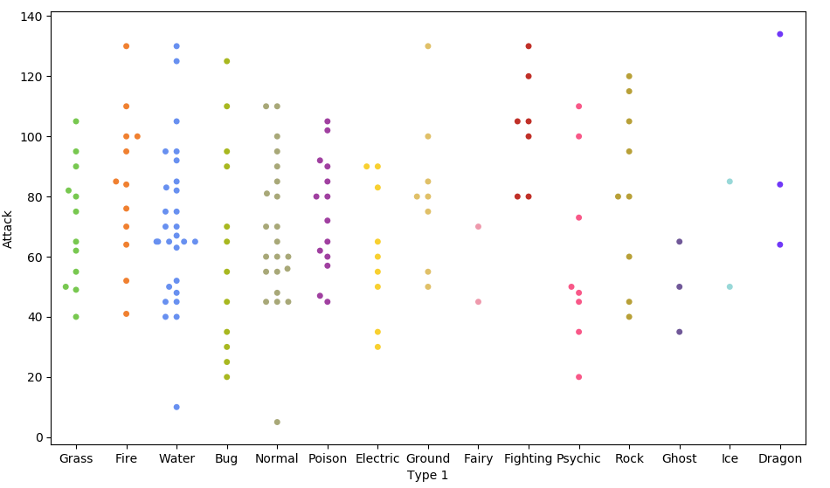
Swarm Plot
Because of the limited number of observations, we could also use a swarm plot.
Here, each data point is an observation, but data points are grouped together by the variable listed on the x-axis.

Slide 38
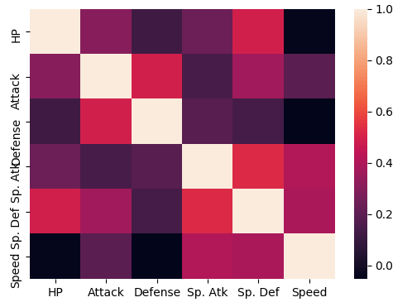

Heatmaps
Useful for visualising matrix-like data.
Here, we’ll plot the correlation of the stats_df variables

Slide 39
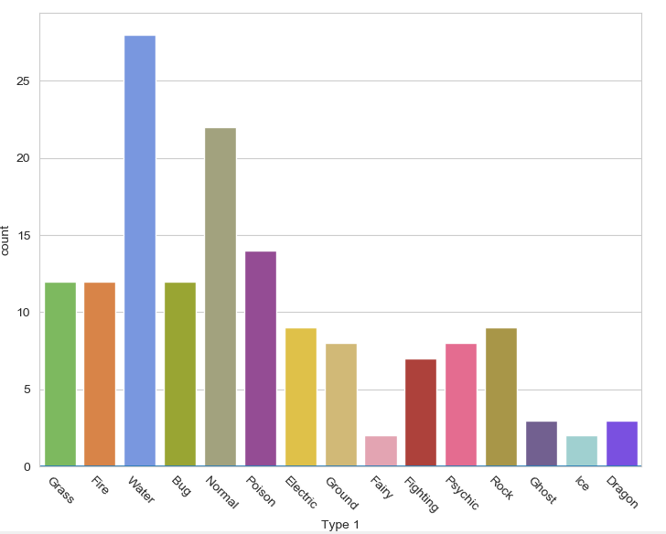

Bar plot
Visualises the distributions of categorical
variables.
Rotates the x-ticks 45 degrees

Slide 40
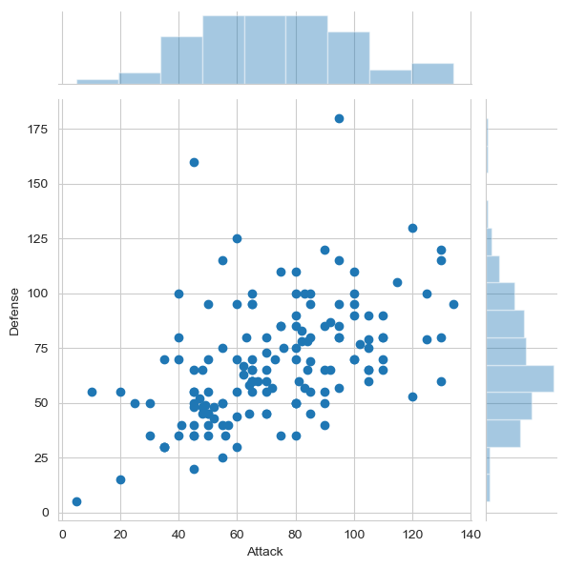

Joint Distribution Plot
Joint distribution plots combine information from scatter plots and histograms to give you detailed information for bi-variate distributions.

Slide 41
Any questions?

